Slide 1
Employee salary prediction using ml algorithms
CAPSTONE PROJECT
Presented By:
Koritala Sailakshmi – Vellore institute of technology – Andra Pradesh – CSBS - STU682b4aadd69561747667629

Slide 2
OUTLINE
Problem Statement (Should not include solution)
System Development Approach (Technology Used)
Algorithm & Deployment (Step by Step Procedure)
Result
Conclusion
Future Scope(Optonal)
References

Slide 3
Problem Statement
This project aims to focus on different machine learning algorithms to predict employee salary based on their education , job role and others. It helps organizations make informed decisions about compensation and HR planning. The model is trained on historical data to find patterns influencing salary. Various algorithms are tested to ensure accuracy and reliability. Ultimately, it offers a practical tool for fair and data-driven salary estimation.

Slide 4
System Approach
System requirements
Programming language : Python
Development Environment : Jupyter Notebook
Model Deployment tool : Streamlit
Operating System: Windows 10/11, macOS, or any modern Linux distribution

Slide 5
System Approach
Library required to build the model
Pandas : Data loading, manipulation, and analysis
Numpy :Numerical operations
Matplotlib : Data visualization (basic plots)
scikit-learn : Machine learning models, preprocessing, evaluation
joblib : Model saving and loading

Slide 6
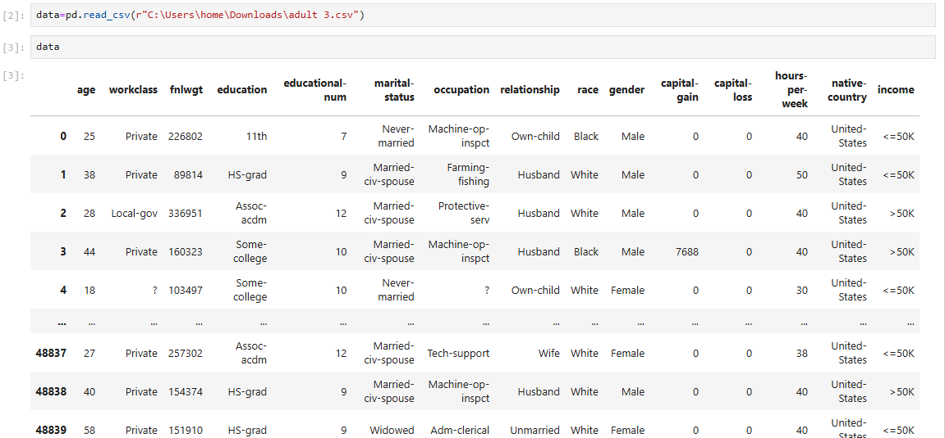
Algorithm & Deployment
1.Import Required Libraries
Load essential libraries: pandas, numpy, matplotlib, seaborn, and scikit-learn.
2.Load the Dataset
Use pandas.read_csv() or a similar function to load the dataset containing employee information and salaries.

Slide 7
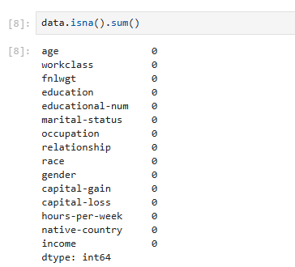
Algorithm & Deployment
3.Explore and Understand the Data
Display dataset structure using head(), .info() .
Using shape() to know the rows and columns of the data .
Check for missing values or inconsistent data types.

Slide 8
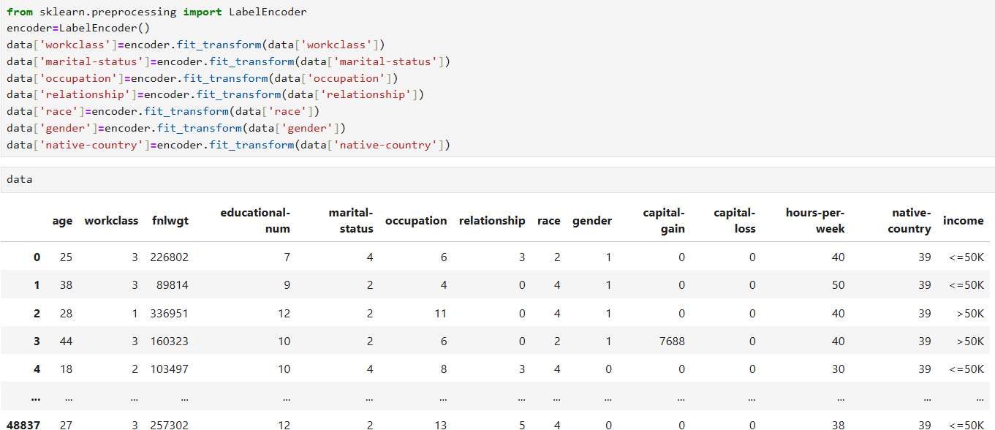
Algorithm & Deployment
4.Data Preprocessing
Handle missing values
Convert categorical features to numerical values using labelEncoder

Slide 9
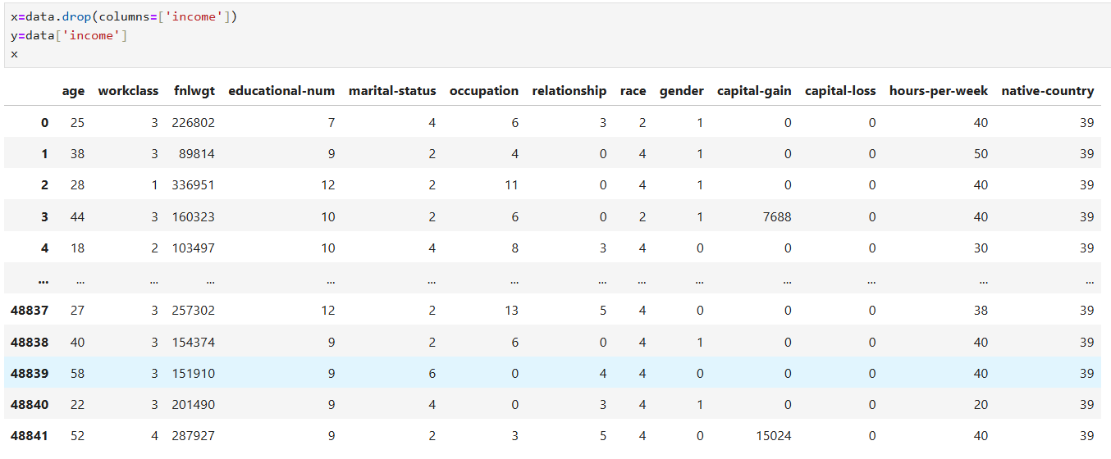
Algorithm & Deployment
5.Feature Selection
Choosing relevant independent variables (education , hours per week , capital gain and others ) and target variable ( Income)

Slide 10
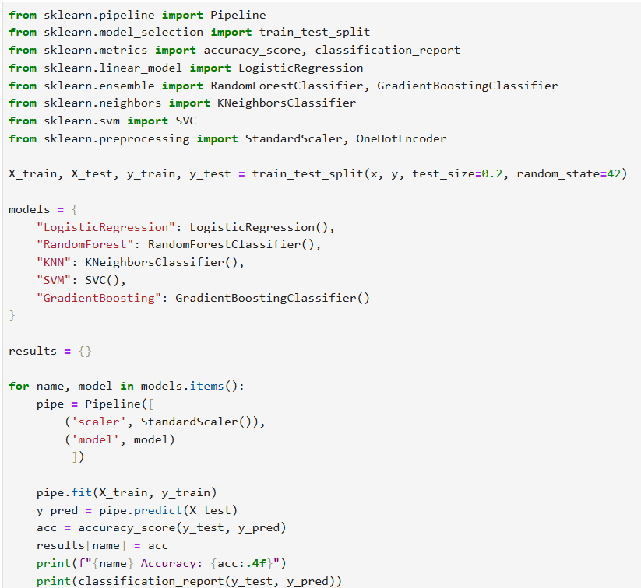
Algorithm & Deployment
6.Split the dataset
Use train_test_split() to divide the data into training and testing sets (commonly 80% training, 20% testing).

Slide 11
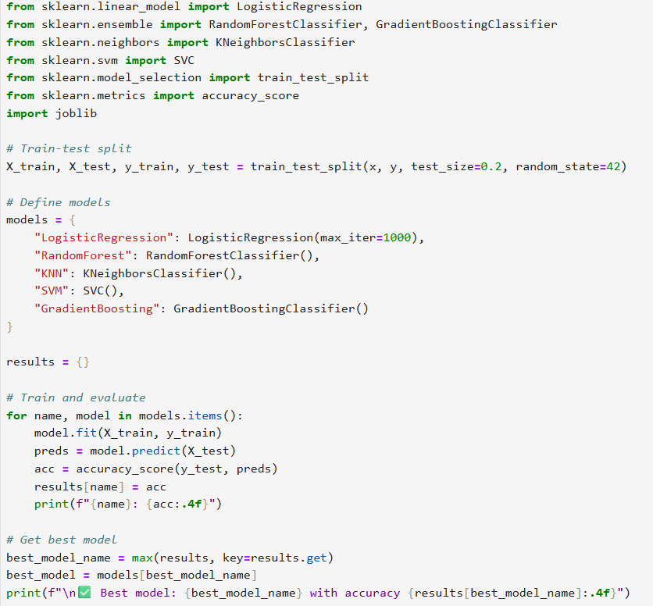
Algorithm & Deployment
7.Model selection and training
Using different regression models such as Linear Regression , RandomForest Regressor , Gradient Boosting Regressor . Training the model using data.fit() .

Slide 12
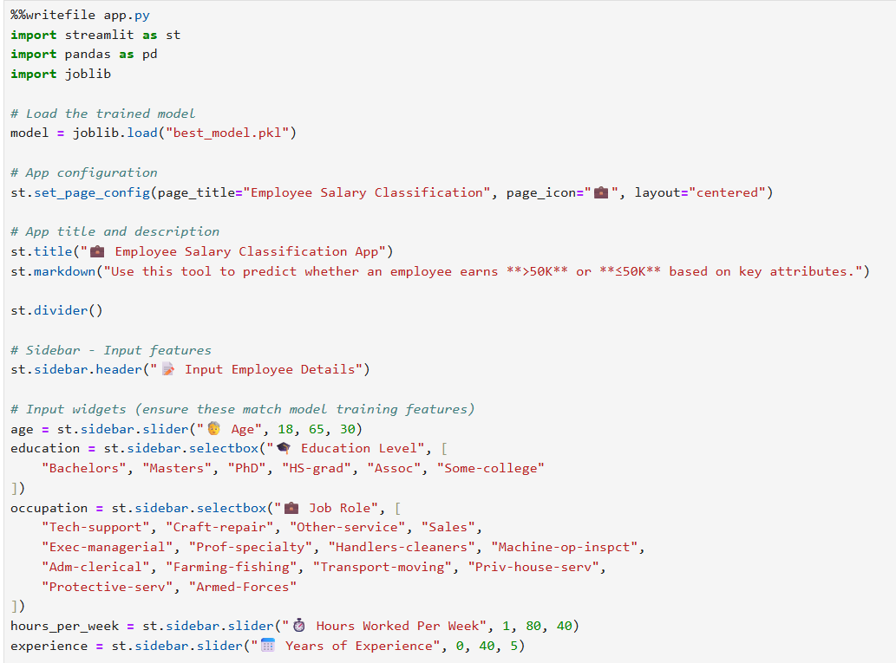
Deployment
8.Deploying the model
Using joblit to save the trained model for future use
Using streamlit to integrate the model for real time prediction

Slide 13
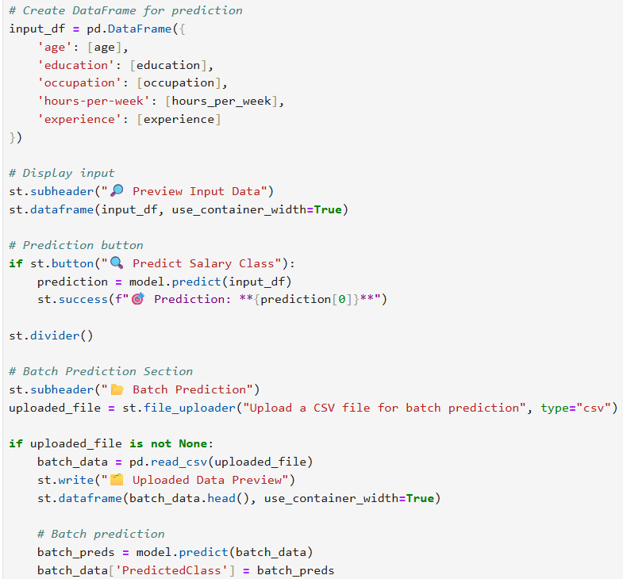
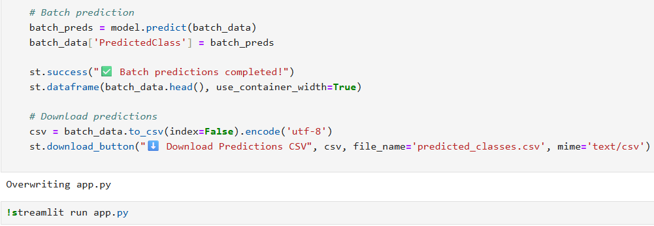
Deployment

Slide 14
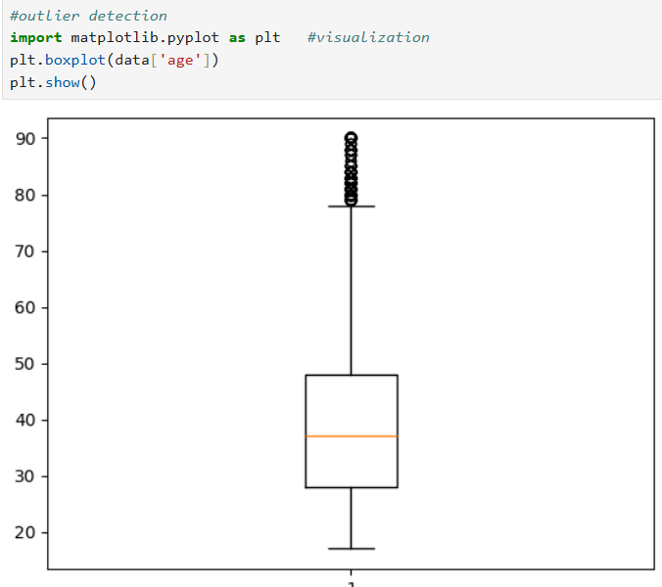
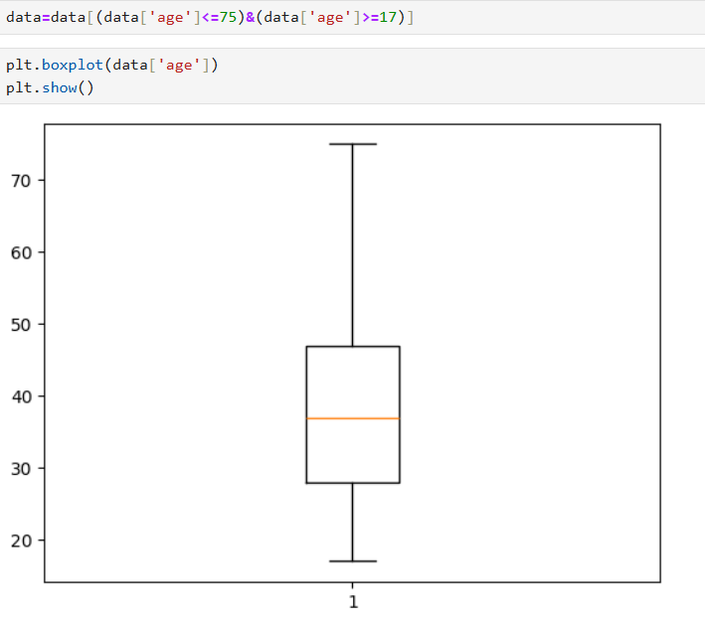
Result

Slide 15
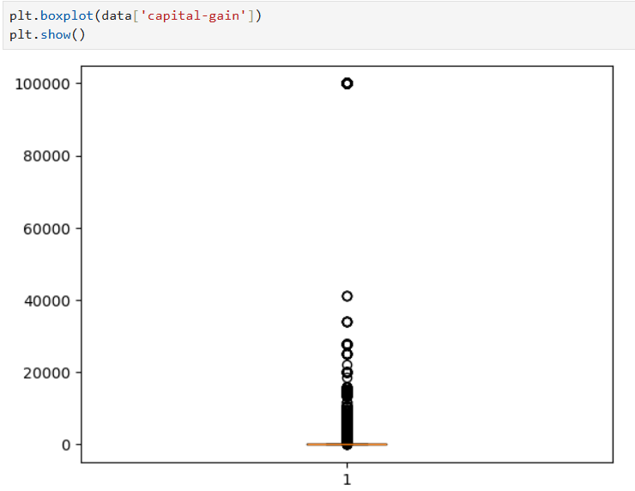
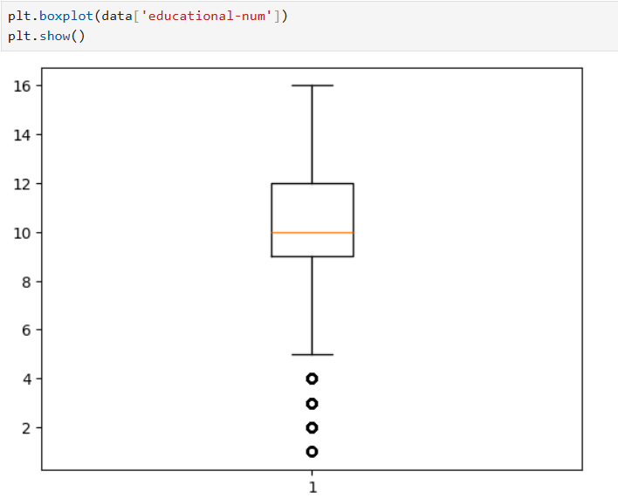
Result

Slide 16
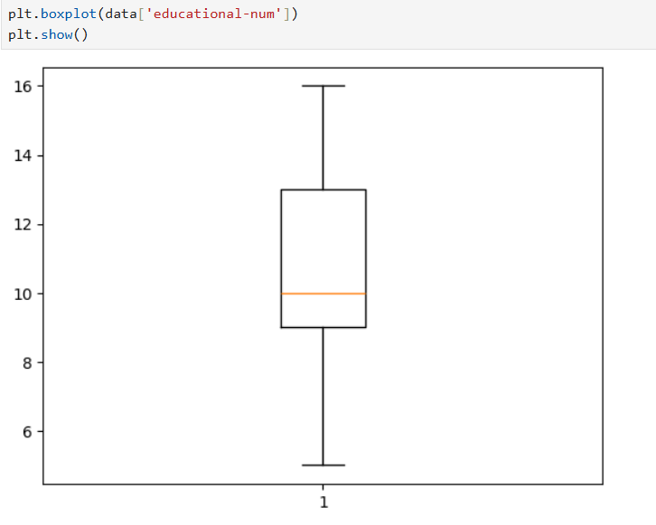
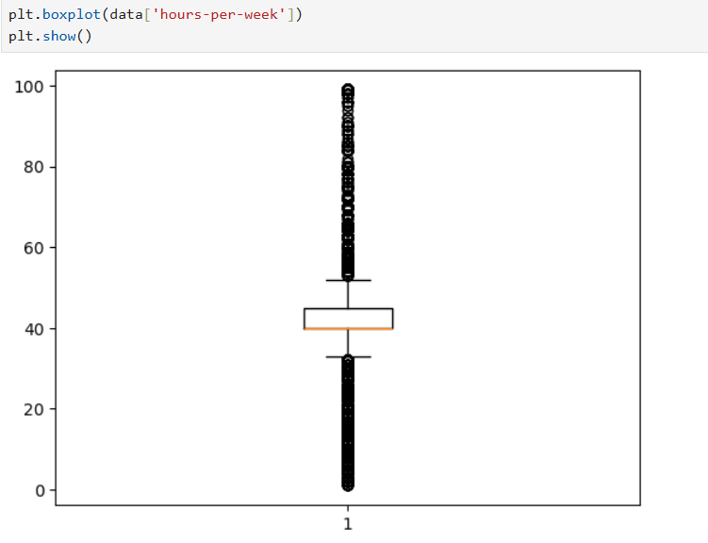
Result

Slide 17
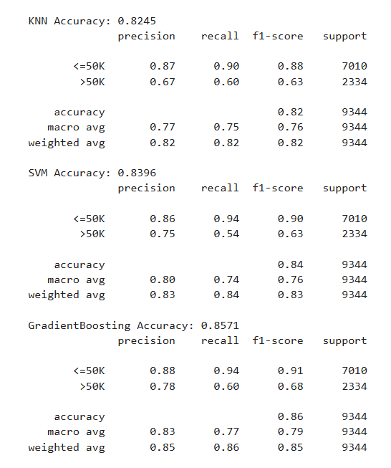
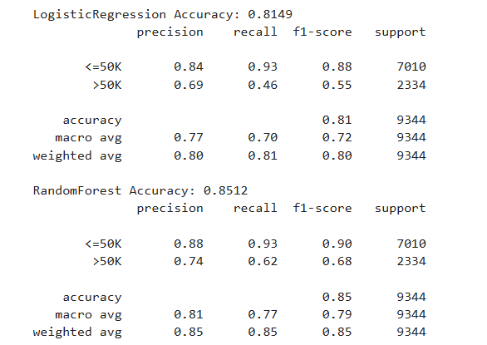
Result

Slide 18
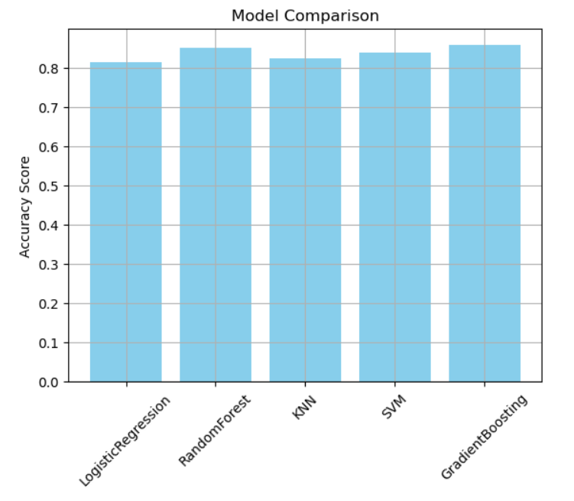

Result

Slide 19
Result
Attach your Github link
Link: https://github.com/koritala-sai/water-quality-prediction

Slide 20
Conclusion
This project successfully predicts employee salaries using machine learning based on key features like experience and education .The model shows good accuracy and practical relevance . It’s a valuable tool for modern workforce management .

Slide 21
References
Matplotlib : https://matplotlib.org
Scikit-Learn : https://scikit-learn.org
Pandas : https://pandas.pydata.org
Numpy : https://numpy.org

Slide 22
THANK YOU

